Slide 1


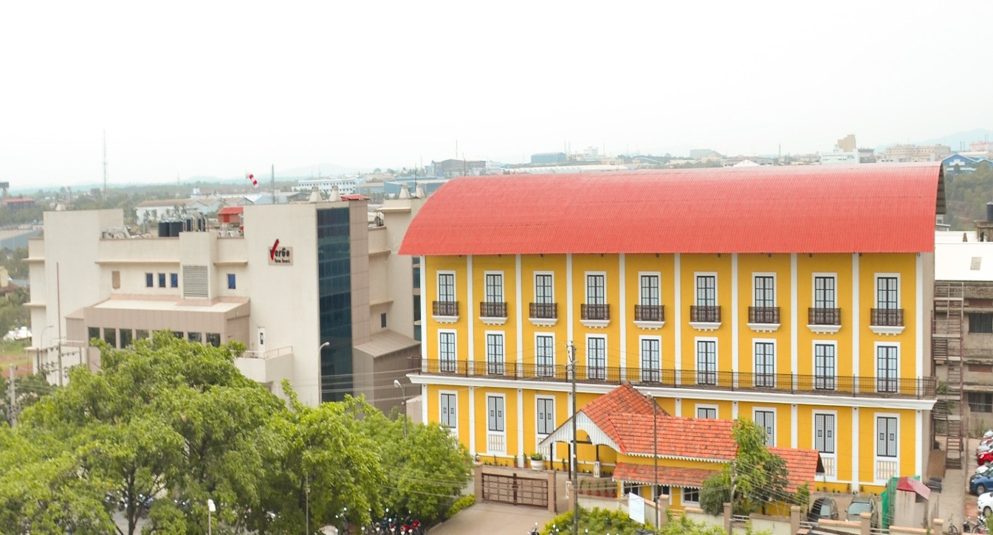
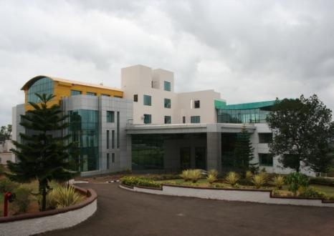
VerGo Group
VerGo Pharma Research Laboratories Pvt Ltd (CDMO), Verna, Goa
VerGo Pharma Research Pvt Ltd
(CRO), Corlim, Goa

Slide 2
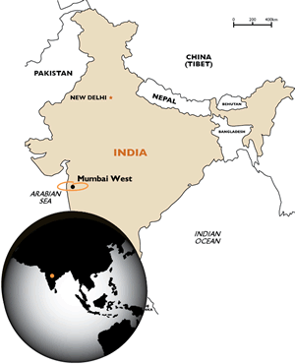
WHO ARE WE?
VERna
GOa
VerGo Pharma Research Laboratories Pvt. Ltd. was formed in Jun-2010 and was registered on Oct-2010.
VerGo Pharma Research Laboratories Pvt. Ltd. has headquarters in Panaji, Goa.
The site is located in a 6,326.43m² facility on a 13,452.64m² plot.

Slide 3
VISION
“To be the leading and most trusted partner for global pharmaceutical companies by providing best in class product development and manufacturing solutions”
MISSION
VALUES
Pursue scientific excellence in product development, innovation and manufacturing to improve quality of life and create value for our customers, partners and stakeholders worldwide
Customer Focus
Team-work
Quality
Innovation
Sustainability
Mutual Respect
Integrity

Slide 4
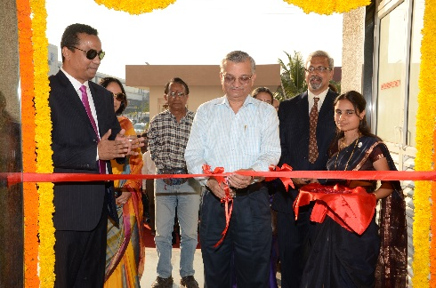






MILESTONES
2010
Founded
2011
Approval by DSIR
2014
Approval by TGA & WHO
2016
Started Commercial manufacturing
2017
Cleared USFDA, SUKL & WHO audits
2020
Cleared MHRA Audit and started Codevelopment Projects
FEI 3009383919

Slide 5
SERVICE PORTFOLIO
Formulation Development
Clinical BA/BE Studies
Analytical Development
ICH Stability Testing
GMP Manufacturing
Custom Synthesis Laboratory

Slide 6
SALIENT FEATURES
STATE-OF-THE-ART INFRASTRUCTURE
MHRA, TGA and WHO approved GMP facility
MHRA, NPRA, DCGI & WHO approved Clinical BA/BE Center
TIMELY PROJECT DELIVERY
Proven project delivery record
CLIENT FOCUS
Integrated project management team
Flexible, independent & non-competitive business model
QUALITY & INNOVATION
End-to-end support from drug development to regulatory filing
Quality-by-Design approach
Successful development of two NCE-1 products
Ability to manage multiple projects simultaneously
Notes:
Four pillars that hold our org together
Spare no quarter on quality

Slide 7
FORMULATION DEVELOPMENT
Taste Masking/ Pelletization/ Micro-encapsulation
Immediate Release, Orally Disintegrating Tablet
Extended Release, Sustained Release
Delayed Release, Modified Release
  Granules
  Tablets
  Capsules
  Bilayer tablets
  Tablets
  Capsules
  Pellets
Highlights:
Pre-formulation
Bio-availability enhancement
Bosch & Glatt Fluid Bed Processor
Special Products Area for the development of high potency and oncology products
  Potent Molecules
  Hormones
  Steroids
  Anti-cancer Drugs
  Liquids
  Solutions
  Powders for suspension
Notes:
Lets talk about the kind of products we develop
From IR to GR ER DR we handle all products injecetables we have a small area for development of ophthalmic solutions
We have done andas 505b2 NCE-1

Slide 8

ANALYTICAL DEVELOPMENT
ANALYTICAL DEVELOPMENT
Method Development
Method Validation
Method Transfers
Stability Assessment & Photo- stability
Structural Elucidation & Impurity Identification
VerGo Analytical Development Laboratory and Quality Control Laboratory were inspected by USFDA in 2017.
VerGo received the EIR in March 2018.
FEI 3009383919
Notes:
To support our fd lab we developed our ADL lab
We have 30 prep hplc we have a fei number in place from us fda
Apart from supporting fd we also take stand alone ad products
We support our CSL team with elucidations

Slide 9
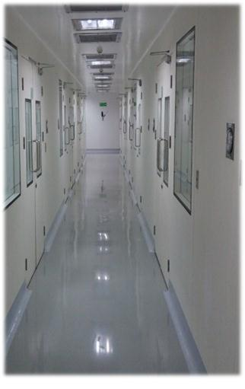


GMP MANUFACTURING
GMP MANUFACTURING
Process Optimization Trials
Exhibit Batch Manufacturing
Clinical Batch Supply
Commercial Manufacturing
Highlights:
GMP facility designed for tablets & capsules
Capacity:
Oral solids: 400,000,000 tabs/annum
Packaging – 2 Blister packing lines
R&D and GMP facilities in the same location
Notes:
List all mfg
Sukl approval tga approval
Solid orals and liquids
One adv is that we can even develop small scale batches as low as 5kg
we are manufacturing commercial batches for our clients

Slide 10


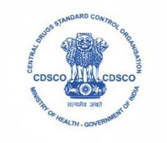
BIO-AVAILBILITY/BIO-EQUIVALENCE STUDIES
CLINICAL BA/BE STUDIES
Pilot & Pivotal BA/BE Studies
Pathology Center
ISO 15189:2012
Data Management
Bio-analytical Testing
Highlights:
100-bed facility (3 clinics)
Studies submitted to MHRA, USFDA, WHO- Geneva, NPRA-Malaysia, MCC and TGA
6 LC-MS/MS
GLP & GCP compliant
Fully equipped ICU
Current expansion 50 beds (4th clinic)
Notes:
It’s a 100 bed state of the art GCP/GLP complaint Bioequivalence center to conduct Pilot and Pivotal BE studies. Our facility is approved by NPRA MALAYSIA and UK-MHRA.
Commissioned by experienced clinical research professionals having wide global exposure, VerGo Clinicals has more than 100 clinical research scientist experienced in various regulatory submission studies. We have done around 150+ studies from our BE facility including submission studies for Health Canada, Health Costa Rica, UK-MHRA and EU submission. We have in-house Bioanalytical Lab with 6 LC-MS/MS and in-house NABL approved Pathology Lab to support all the testing requirements

Slide 11
BIO-AVAILBILITY/BIO-EQUIVALENCE STUDIES
Salient Feature:
CLINICAL SERVICES
BA/BE Studies- Healthy subjects and patients
Clinical end-point studies
Pool of 8500 volunteers
2-bed ICU
100 bed facility
BIO-ANALYTICAL
6 LC MS/MS
6 Deep freezers
-20ºC walk in chamber
Well-equipped processing laboratory
Software: WinNonlin 6.3 and SAS 9.3
Timelines: 45-60 days
3 weeks or less for new method development and validation
DATA & PROJECT MANAGEMENT
Notes:
It’s a 100 bed state of the art GCP/GLP complaint Bioequivalence center to conduct Pilot and Pivotal BE studies. Our facility is approved by NPRA MALAYSIA and UK-MHRA.
Commissioned by experienced clinical research professionals having wide global exposure, VerGo Clinicals has more than 100 clinical research scientist experienced in various regulatory submission studies. We have done around 150+ studies from our BE facility including submission studies for Health Canada, Health Costa Rica, UK-MHRA and EU submission. We have in-house Bioanalytical Lab with 6 LC-MS/MS and in-house NABL approved Pathology Lab to support all the testing requirements

Slide 12
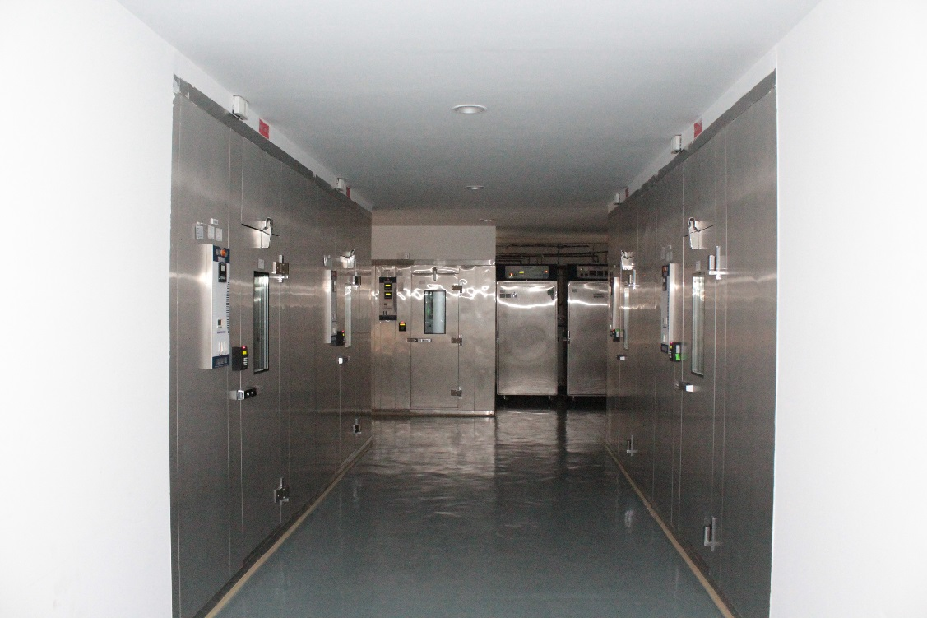
ICH STABILITY STUDIES
ICH STABILITY STUDIES
Protocol Design
Sample retention, recording & tracking
Stability Testing of API, Finished Product & Containers
Expiration Dating
Highlights:
MHRA, DCGI, TGA & WHO approved facility
Capacity:
100,000L & expandable up to 250,000L
Cater to all ICH Zones
Notes:
100 thousand litre capacity
We have a backup power supply for our heaters and humidifiers
We have softwares to record data to ensure data integrity

Slide 13
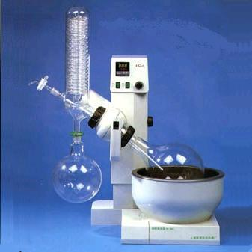
CUSTOM SYNTHESIS LABORATORY
CUSTOM SYNTHESIS LABORATORY
Process Development & Scale-up
NCE Intermediates
Drug Impurity Standards & Metabolites
Highlights:
Scale-up from milligram to kilogram
120 linear feet fume hood
Parr hydrogenation apparatus
Heidolph rotary evaporators
Fully equipped analytical support
Notes:
We do custom synthesis of impurities standards nucleic acid pet etc . We have a chemistry lab in place
900 impurities in stock
custom synthesis laboratories specialized in the synthesis of Pharmaceutical Impurities, API process development, Intermediates, Metabolites, Nuclear medicinal precursors, Herbal marker compounds and Herbal reference substances. We provide the custom synthesis solutions for innovative molecules and also do impurity profiling, troubleshooting analytical and chemistry work for our customers. We can also provide FTE research services as per client’s regular requirement. The major advantage of working with us for impurities and other custom synthesis requirement is we have a dedicated in–house state of the art analytical facility to support our custom synthesis

Slide 14
VALUE ADDITION
API sourcing assistance
RLD sourcing assistance
R&D
Formulation development
Analytical development
MFG
GMP regulatory manufacturing
Regulatory filing submission support
Commercial supply
BA/BE
Pilot BE studies
Regulatory
ICH stability studies
API/RLD
Pivotal BE studies
Regulatory Support
Approval
Filing
Client
Product

Slide 15


Contact Us
VerGo Pharma Research Laboratories Pvt Ltd (VerGo Labs)
VerGo Pharma Research Laboratories Pvt. Ltd., Plot No. B5, B22, B23 and B23A,
Phase 1A, Verna Industrial Estate,
Verna, Goa - 403722, India
Telephone: +91-832- 6682858
VerGo Pharma Research Pvt Ltd (VerGo Clinicals)
VerGo Clinicals, Plot 24/1, D-1
Mologa de Orora, Corlim,
Tiswadi, Goa - 403110 India
Telephone: +91-832- 6640400
www.vergolabs.com

